Slide 1

Day 2: Spatial Autocorrelation
Short Lecture & Computer Practical
Dr Anwar Musah (a.musah@ucl.ac.uk)
Lecturer in Social and Geographic Data Science
UCL Geography
1
Notes:
How do we quantify, measure and interpret the degree spatial dependence “globally” and “locally”?
Global Moran’s I statistic
Local Indicators of Spatial Association (LISA)
Tips on making statistical inference & interpretation of the results churned from methods highlighted in Point 4

Slide 2
Definition [1]
Recall Tobler’s 1st Law of Geography
Spatial dependence is the propensity for how nearby objects in geographic space tend to influence each other. It’s a reflection of how values observed at one location (e.g., city, region, country) is dependent on the values of neighbouring observations from nearby locations.
Spatial autocorrelation
This describes the degree of how spatial locations (i.e., points, areas, or raster cells) close to each other share similar values (i.e., locations that are akin to each other).
2
Notes:
When we are examining spatial autocorrelation – these location-specific

Slide 3
Definition [2]
Spatial autocorrelation: This describes the degree of how spatial locations (i.e., points, areas, or raster cells) close to each other share similar values (i.e., locations that are akin to each other).
We can test our data for spatial autocorrelation, with some form of statistical measure of the similarity of attributes of our data.
We want to distinguish between areas of positively autocorrelated patterns (in which areas with high values are surrounded by areas with high values, and areas with low values that are surrounded by areas with low values to, i.e., clusters);
3

Slide 4
Definition [3]
Spatial autocorrelation: This describes the degree of how spatial locations (i.e., points, areas, or raster cells) close to each other share similar values (i.e., locations that are akin to each other).
The hypothesis statement for testing evidence for spatial autocorrelation
Null hypothesis: The outcome of interest are spatially independent (i.e., patterns are random)
Alternative hypothesis: The outcome of interest are not spatially independent (i.e., hence, there is evidence of clustering or dispersion)
4

Slide 5
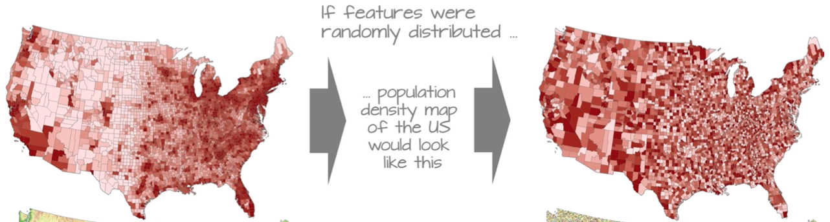




































We can apply these hypotheses tests on these scenarios
Null hypothesis: The spatial patterns for the US Population Density are independent. They are random. [Here, we would reject the null hypothesis]
Alternative hypothesis: The patterns for the US Population Density are not random. They are indeed clustered. [Here, we would accept the alternative hypothesis]
Scenario 1: US Population Density
5
Notes:
Suppose, the image on my right side was true – we would…

Slide 6
































We can apply these hypotheses tests on these scenarios
Null hypothesis: The spatial patterns for the US Population Density are independent. They are random. [Here, we would accept the null hypothesis]
Alternative hypothesis: The patterns for the US Population Density are not random. They are indeed clustered. [Here, we would reject the alternative hypothesis]
Scenario 2: US Population Density
6
Notes:
Suppose, the image here was true – we would…

Slide 7
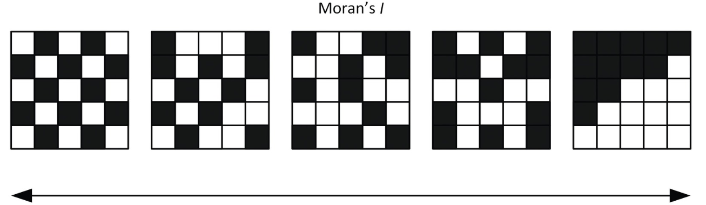
Statistical analysis: Moran’s I statistic [1]
In testing for evidence of spatial autocorrelation, the Moran’s I statistic, which is a weighted correlation coefficient, is the statistical test used to detect departures from spatial randomness. Departures from randomness indicate spatial patterns such as clusters (+) or dispersed (-). This statistic is accompanied with a p-value to determine significance
Dispersed
Random
Clustered
Moran’s I statistic:
-1
0
+1
Positive Moran’s I value is when spatial autocorrelation generally indicates that nearby area have similar values, indicating spatial clustering. This is a spatial pattern!
Negative Moran’s I spatial autocorrelation generally indicates that nearby area have dissimilar values, this is dispersion of values is indeed a spatial pattern!
A Moran’s I value closer to 0 means no evidence of spatial autocorrelation. No discernible spatial pattern!
7

Slide 8
Statistical analysis: Moran’s I statistic [2]
In testing for evidence of spatial autocorrelation, the Moran’s I statistic, which is a weighted correlation coefficient, is the statistical test used to detect departures from spatial randomness. Departures from randomness indicate spatial patterns such as clusters (+) or dispersed (-). This statistic is accompanied with a p-value to determine significance
There are two ways for statistically measuring spatial autocorrelation:
Global Moran’s I statistic: What is the overall spatial dependence across the entire data set area? Studying at a global level will tell you how clustered, dispersed or random the data is distributed over the entire area studied.
LISA (Local Indicators of Spatial Association): What is the difference between each unit of analysis (e.g., areal unit) and its neighbours? We use it for studying at the local level, you can find areas of greater contrast by seeing if places are quantifiably more like or dislike with their neighbours than expected on average.
If the p-value is less than 0.05, we can reject the null hypothesis in favour of the alternative hypothesis and arrive at the conclusion that the patterns are significantly clustered. If the p-value is above 0.05, it means that the clustering/dispersed patterns are not significant, thus we can conclude patterns are random.
8
Notes:
LISA’s are slightly different because these are scores. So, these are not bounded between -1 to +1

Slide 9
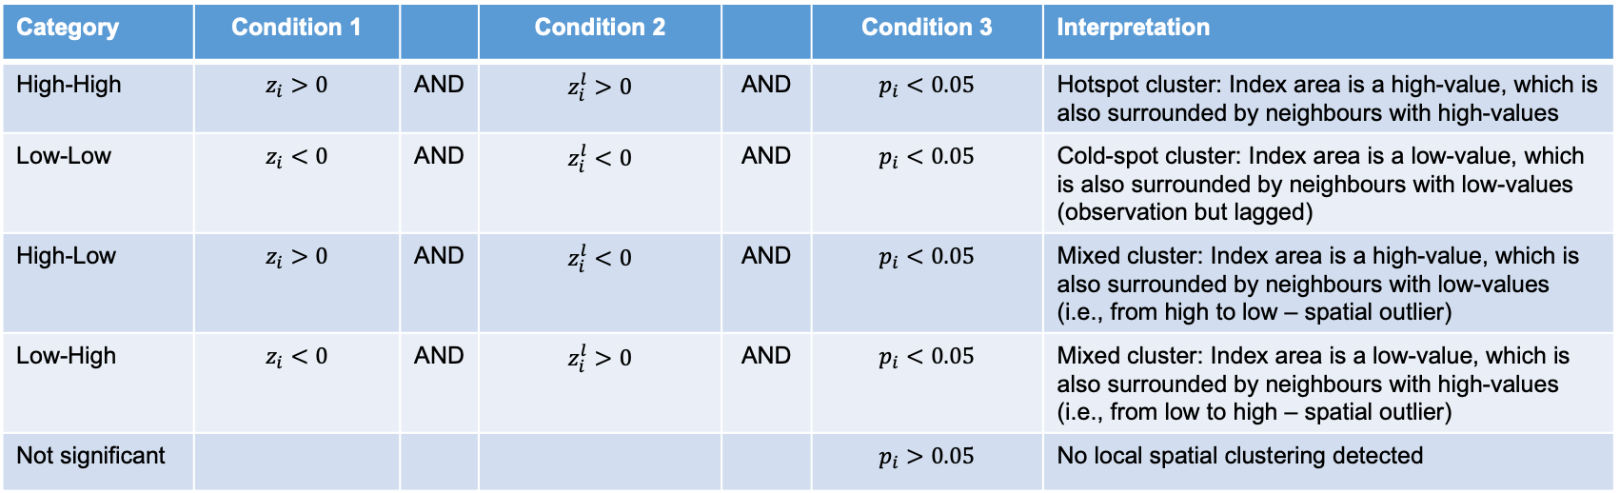
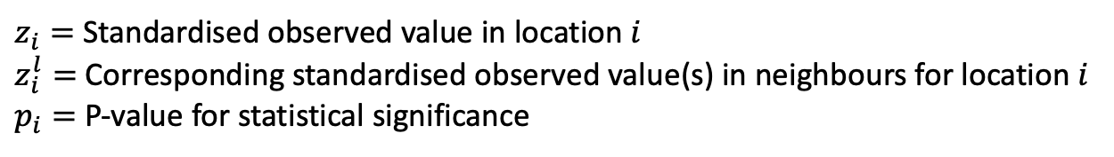
Cluster type and categorisation scheme from LISA analysis
Category | Condition 1 |  | Condition 2 |  | Condition 3 | Interpretation
High-High | $$z_{i}>0$$ | AND | $$z_{i}^{l}>0$$ | AND | $$p_{i}<0.05$$ | Hotspot cluster: Index area is a high-value, which is also surrounded by neighbours with high-values
Low-Low | $$z_{i}<0$$ | AND | $$z_{i}^{l}<0$$ | AND | $$p_{i}<0.05$$ | Cold-spot cluster: Index area is a low-value, which is also surrounded by neighbours with low-values (observation but lagged)
High-Low | $$z_{i}>0$$ | AND | $$z_{i}^{l}<0$$ | AND | $$p_{i}<0.05$$ | Mixed cluster: Index area is a high-value, which is also surrounded by neighbours with low-values (i.e., from high to low – spatial outlier)
Low-High | $$z_{i}<0$$ | AND | $$z_{i}^{l}>0$$ | AND | $$p_{i}<0.05$$ | Mixed cluster: Index area is a low-value, which is also surrounded by neighbours with high-values (i.e., from low to high – spatial outlier)
Not significant |  |  |  |  | $$p_{i}>0.05$$ | No local spatial clustering detected
$z_{i}=$Standardised observed value in location$i$
$z_{i}^{l}=$Corresponding standardised observed value(s) in neighbours for location $i$
$p_{i}=$ P-value for statistical significance
9
Notes:
HH: A location with a high value is surrounded by neighbours with high values. This indicates a spatial cluster of high values (positive spatial autocorrelation). Interpretation: It can be seen as a "hot spot.”
LL: A location with a low value is surrounded by neighbours with low values. This indicates a spatial cluster of low values (positive spatial autocorrelation). Interpretation: It can be seen as a "cold spot.”
HL: A location with a high value is surrounded by neighbours with low values. This indicates a spatial outlier (negative spatial autocorrelation). Interpretation: The location deviates from its neighbors, creating a potential anomaly.
LH: A location with a low value is surrounded by neighbours with high values. This also indicates a spatial outlier (negative spatial autocorrelation). Interpretation: Like HL, this suggests the location behaves differently compared to its surroundings.
Overall mean qualification, Spatial-lag mean (direct neighbours)

Slide 10
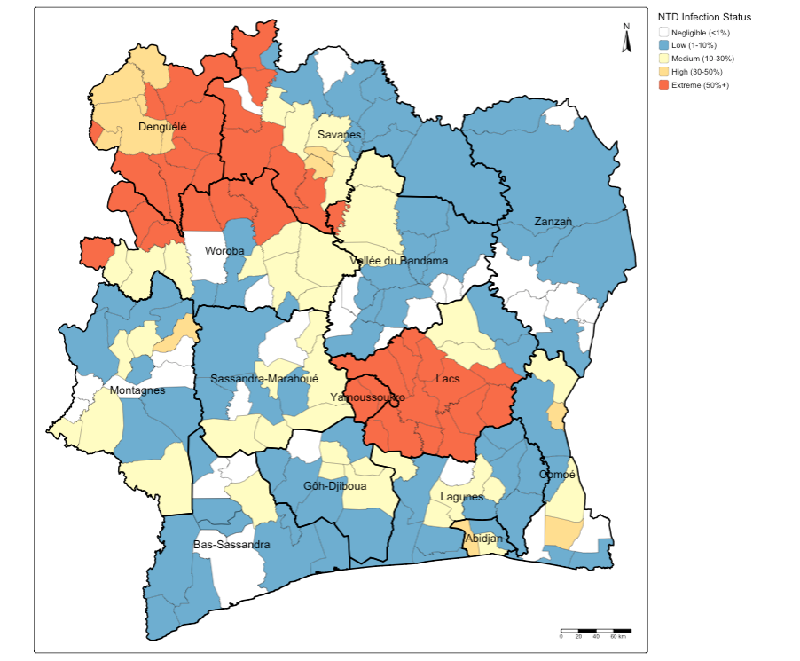
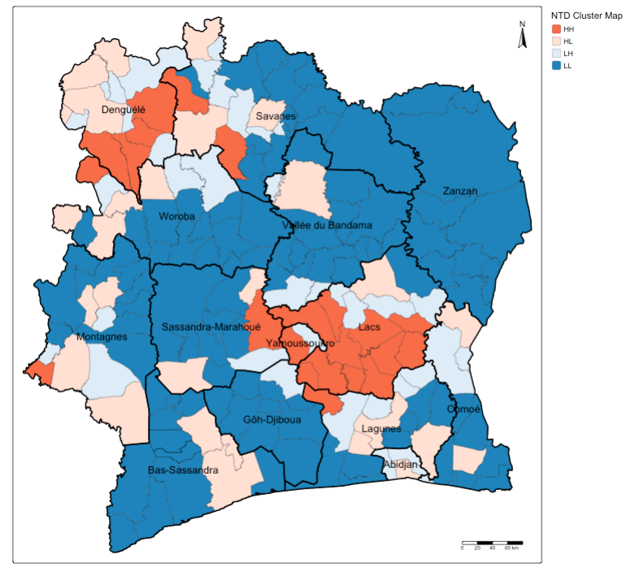
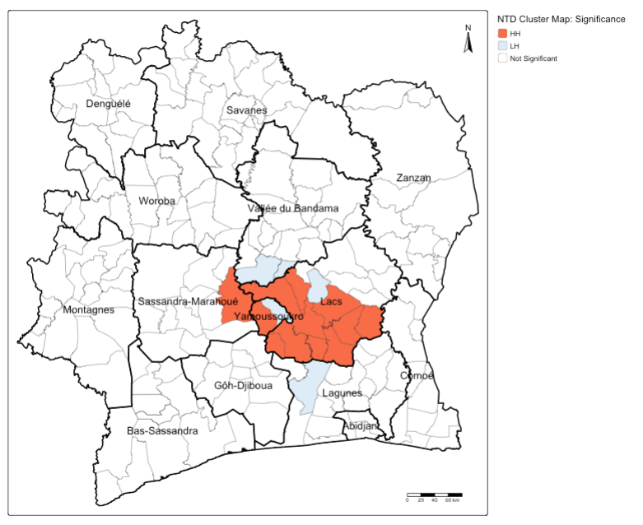
Example:
Detection of NTDs clusters in Cote d’Ivoire
A. Distribution of NTDs by Endemicity status
B. Shows where the cluster of NTDs are concentrated – classed as ‘High-High’, ‘High-Low’, ‘Low-High’, ‘Low-Low’.
C. Shows which of the cluster classes where NTDs are concentrated are statistically significant
We will generate this output in the computer practicals
10
Notes:
HH: A location with a high value is surrounded by neighbours with high values. This indicates a spatial cluster of high values (positive spatial autocorrelation). Interpretation: It can be seen as a "hot spot.”
LL: A location with a low value is surrounded by neighbours with low values. This indicates a spatial cluster of low values (positive spatial autocorrelation). Interpretation: It can be seen as a "cold spot.”
HL: A location with a high value is surrounded by neighbours with low values. This indicates a spatial outlier (negative spatial autocorrelation). Interpretation: The location deviates from its neighbors, creating a potential anomaly.
LH: A location with a low value is surrounded by neighbours with high values. This also indicates a spatial outlier (negative spatial autocorrelation). Interpretation: Like HL, this suggests the location behaves differently compared to its surroundings.
Overall mean qualification, Spatial-lag mean (direct neighbours)

Slide 11
Let’s go to the practicals!
11

